Slide 1
Code 102: Intro to Software Development
Class 01
Notes:
Welcome to class!

Slide 2
Agenda
Campus Orientation & Intros
Learning to Learn
Growth mindset
Demo & Lab
Web Publishing
Markdown
GitHub Pages
Notes:
Here’s our plan for class today

Slide 3
Agenda
Campus Orientation & Intros
Learning to Learn
Growth mindset
Demo & Lab
Web Publishing
Markdown
GitHub Pages

Slide 4
<welcome>
Code 102: Intro to Software Development
Notes:
Welcome! Welcome to the next step in your journey into software development, and possibly even a career in tech.
This sequence of courses has helped first dozens of people, then hundreds of people, and now over a thousand people meaningfully change their lives and launch new careers.
I’m very excited to share this learning journey with you!

Slide 5
Campus Orientation
We designed this place to help you learn
“Thank you for a friendly environment, instead of feeling overwhelmed I felt welcome and able to learn. I can't wait to come back!”
—Code 101 student
Notes:
Please know: We strive to make this a place of excellent, accelerated learning. Please let us know right away if it is anything but that.

Slide 6
Our Vision
<Software development skills for a better life, for a better community, and for a better world.>
Notes:
We see a world where YOUR NEW SKILLS provide you with a better life, empower you impact your community, and make this world a better place for all.

Slide 7
Our Mission
<We guide people from all backgrounds to change their lives through fast-paced, career-focused education. We shape passionate coders with immersive training to meet industry needs and improve diversity in the tech scene.>

Slide 8

Code of Conduct
Safe Learning Environment
This is an environment where every individual is safe and respected.
Harassment and discrimination of any kind will not be tolerated.
If you have concerns, please notify your instructor, Campus Director, and/or email us at conduct@codefellows.com.
Full code of conduct pinned at: github.com/codefellows

Slide 9



The Campus
“Do not disturb” (universal sign)
See whiteboard
Brother™ printer near coffee

Slide 10




The Campus
Door codes: See whiteboard
Designated smoking areas
Bikes parked in garage
Only staff are allowed to bring dogs, except for designated service animal

Slide 11






The Campus

Slide 12

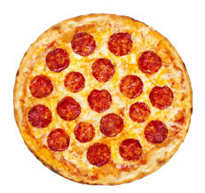

Important Campus Etiquette
If you empty the coffee, please make more!
Only eat food that you bring or is designated for you. Do not eat another cohorts presentation celebration meal!
Please do not use staff kitchen in back.
Absolutely do not touch the desks of staff. The instructors are accessible but their stuff is not!
Notes:
And a few reminders to make proud those who raised you…

Slide 13
The Classroom
Expectations
90% attendance required
Engage in equal participation
90% overall grade is required to pass this course
Assignments are pass/fail
There is homework
Quizzes allow you to review key concepts
Final exam is pass/fail: >12 correct is required to pass the course.
Notes:
Equal participation: For some this will mean stepping forward a bit more. For others, it will mean stepping back a bit to allow others an opportunity.
Assignments are auto-graded: Get feedback directly from classmates, TA, instructor, in class… There will be many opportunities.
There is homework: Reading assignments prior to lecture, lab work not completed in class.

Slide 14
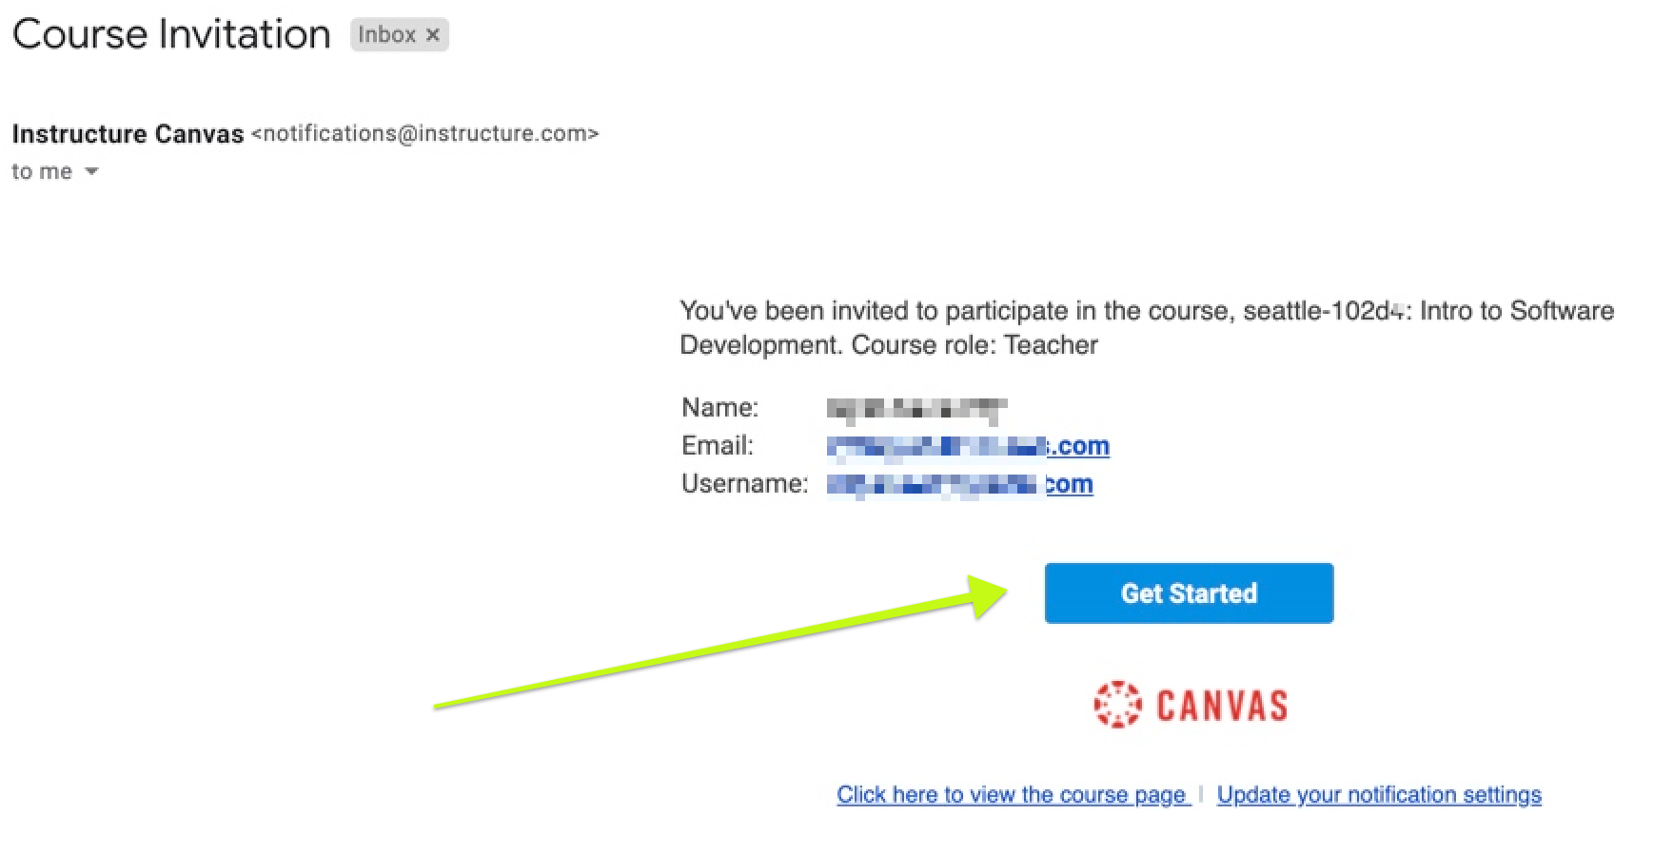
The Classroom: Canvas
Notes:
Canvas is where you will find your assignments, and submit your work in discussion with your classmates.
Right now: Go to settings, and change your TIMEZONE.

Slide 15
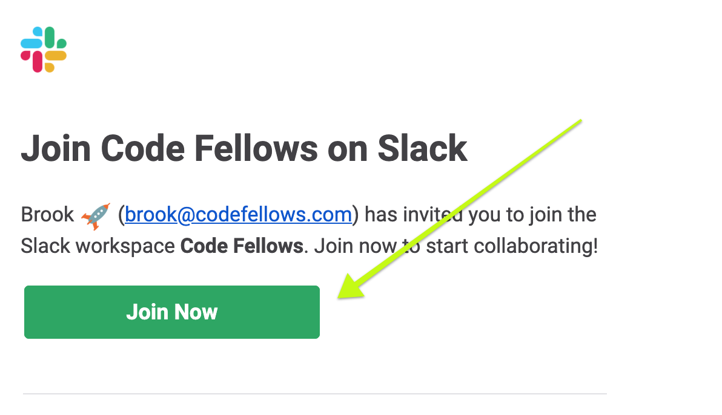
The Classroom: Slack
Notes:
Slack is where you can chat with classmates, instructors, and staff.

Slide 16

Introduce yourself! Tell us ...
Who are you?
What industry did you come from?
Share why you are in this class, now?
A fun and/or geeky fact about you?
Notes:
Introductions!
Instructor should introduce themselves first, with their Professional Pitch.

Slide 17
Agenda
Campus Orientation & Intros
Learning to Learn
Growth mindset
Demo & Lab
Web Publishing
Markdown
GitHub Pages
Notes:
Take a break before proceeding!

Slide 18
<how to succeed>
Prepare to fail: it is part of the skill development process
Notes:
You are here to learn new skills.
Your brain is your most important tool. Not my slides, not the text book... Let’s talk about how to use your brain most effectively.
This might be the most important thing I can tell you in your entire time in our classes.

Slide 19
Learn to Learn
“Muad'Dib learned rapidly because his first training was in how to learn. And the first lesson of all was the basic trust that he could learn. It is shocking to find how many people do not believe they can learn, and how many more believe learning to be difficult. Muad'Dib knew that every experience carries its lesson.”
—Frank Herbert
Author, Dune
Notes:
Great quote about a character from the excellent Sci-Fi book, Dune.
How much trust do you have in your ability to learn?

Slide 20
How You Will Learn
Let’s take a look a the different learning styles used in this course
Path Learning
Sandbox Learning
Leads you along
Students are consumers of information
Predictable outcomes
Creates dependency
The goal: an exchange of information
Fosters exploration
Students are co-creators of their own learning experience
Wide range of outcomes
Creates autonomy
The goal: learning and discovery
Notes:
TELL: Today you’ll have different learning experiences. Some portions of the class will be what we call “path” learning: we’ll show you how to do something, and you can follow along and replicate what we do. Other portions of the class are what we call “sandbox” learning: we’ll give you a task with a few guidelines (think of these as the sides of the sandbox), and then what you do and learn within those guidelines is up to you.
TELL: You may recall the experience of a sandbox environment: it can feel overwhelming and/or uncomfortable at first. That’s okay! Just like there are skills for learning in a path environment, like taking notes, asking clarifying questions, and listening, there are skills for learning in a sandbox environment: defining what you want to learn and how you want to learn it, adjusting course when necessary, and being able to identify when you’ve learned it. Like any skills, they take time and practice to acquire. Here at Code Fellows, we intentionally use a mix of both path and sandbox learning to help you learn concepts, and also learn how to learn - an important skill for software developers.

Slide 21
Skills for Sandbox Learning
Generating and selecting ideas: what do you want to learn now?
Planning your learning: managing scope, finding resources
Experimentation: keeping track of what you’ve tried, what’s worked, and what hasn’t
Reflection: pausing every so often to tally what you’ve learned, and what new questions you have
Finding help!
Notes:
TELL: Here’s just a few of the skills you’ll be learning “in the sandbox.”
Generating Ideas: sometimes you have complete freedom to decide what to learn, other times it’s driven by the needs of your project or job. Programmers like to say, “what’s the problem you’re trying to solve?” This can be big, like “we need some way for people to know when the bus is coming,” or small, like “how do I change the background color of my site?”
Planning - Managing Scope: this is an ongoing process of deciding: do I need to learn/do x to accomplish y? Am I setting too ambitious of a goal? Or is this so cool that I want to refocus all my attention on learning x? Managing scope is a big deal in a programmer’s world: it’s very easy to go down a rabbit hole and end up getting nothing done. (Hence, TDD and MVP.)
Planning - Finding Resources: knowing what to Google, and how to understand what you find, is a skill...and it takes time to develop.
Experimentation: knowing what you’ve tried, what’s worked, and what hasn’t.
Reflecting: it helps to lift your head up out of the weeds/code every so often, and take stock of where you are and where you need to go.
Finding Help: developers absolutely cannot go it alone - they ask for help from their teammates, co-workers, and other developers. We’re here to help you at any stage in this process, from helping you brainstorm ideas to figuring out where to go next.

Slide 22
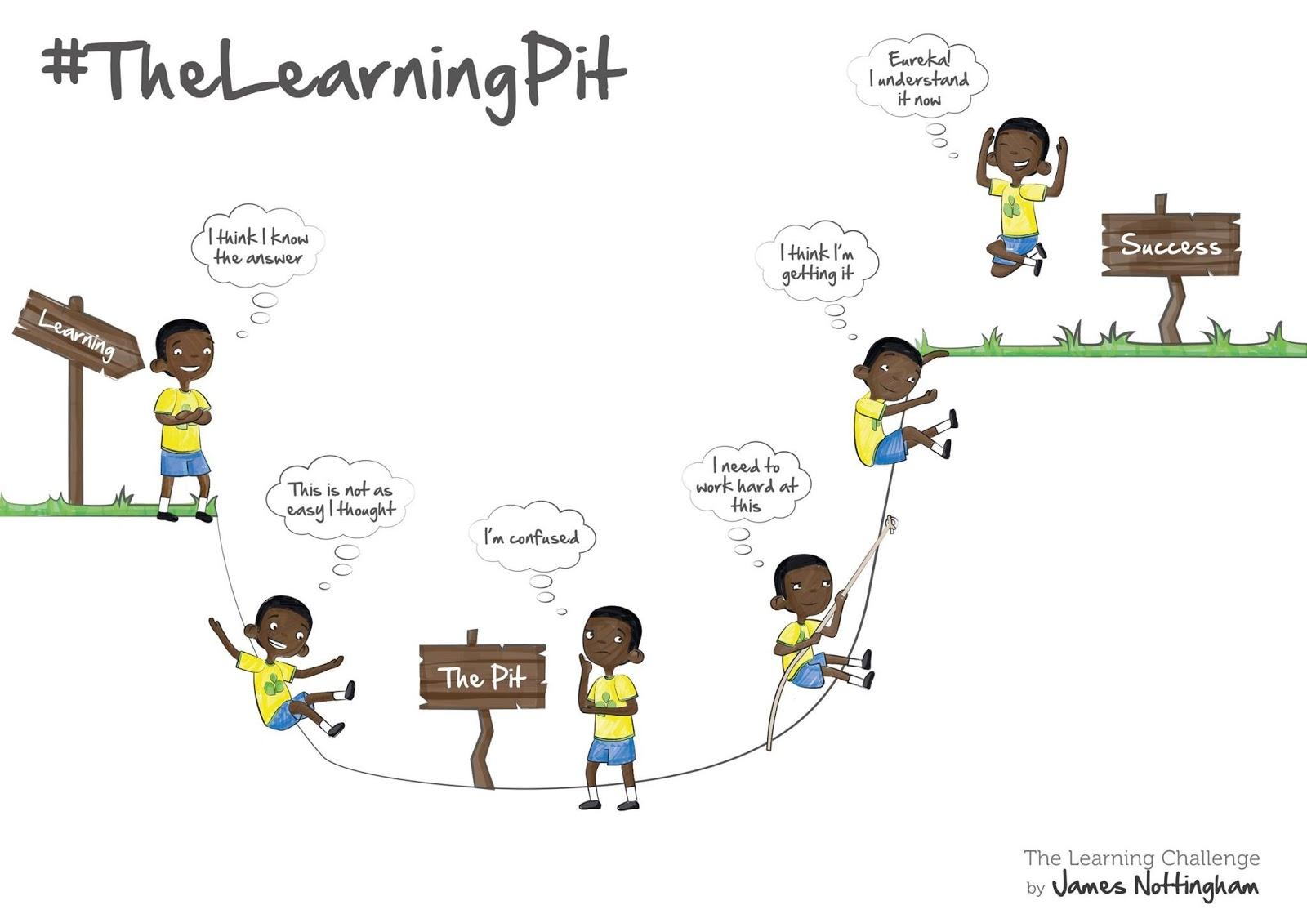
Notes:
Learning actually goes more like this.
Getting to the next level always requires the effort of engaging with the challenges you’ll surely face.
Deciding to work hard is the crucial step. It all comes down to your MINDSET.

Slide 23
What is Mindset?
Mindset: self-perception or “self-theory” that people hold about themselves.
Fixed mindset: believing basic qualities, like intelligence or talent, are simply fixed traits. Believing that talent alone creates success—without effort.
Growth mindset: believing that people’s most basic abilities can be developed through dedication and hard work—brains and talent are just the starting point.
Notes:
What are we talking about when we say “Mindset”?
People generally have a self perception that falls into one of two camps.
But wait! Isn’t IQ fixed throughout someone’s life? There’s a simple test to measure IQ, afterall!
How fixed do you think your IQ is? [thumb-scale]

Slide 24
Prepare Your Brain
“A few modern philosophers assert that an individual’s intelligence is a fixed quantity, a quantity which cannot be increased. We must protest and react against this brutal pessimism… With practice, training, and above all, method, we manage to increase our attention, our memory, our judgement and literally to become more intelligent than we were before.”
—ALFRED BINET
Inventor of the IQ test
Notes:
Any idea who said this quote?

Slide 25
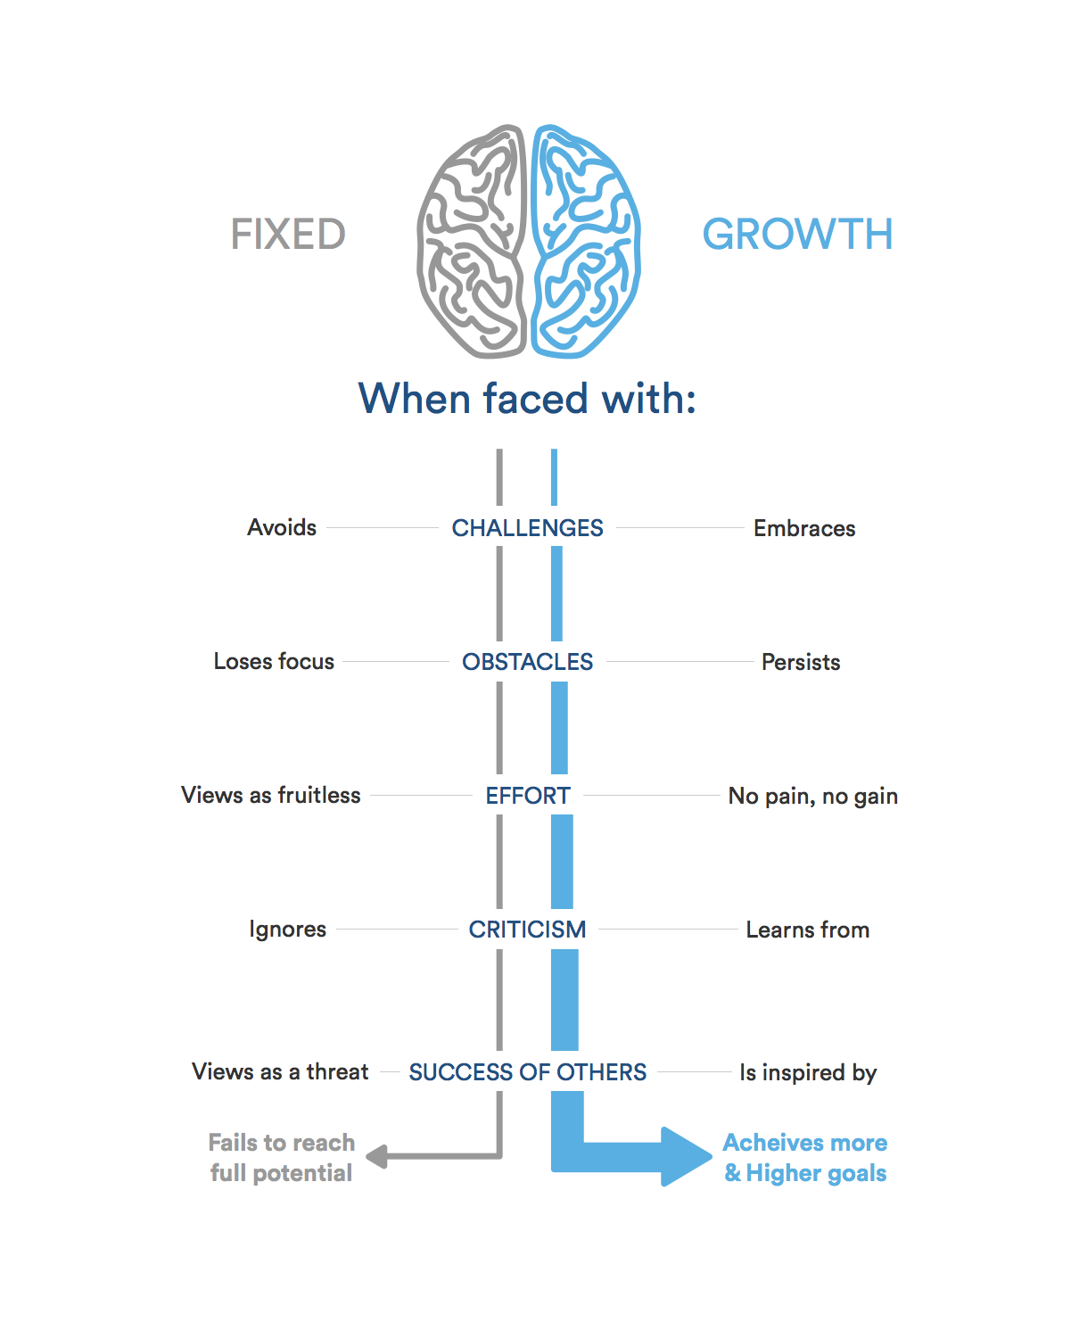
Image: https://www.atlassian.com/blog/inside-atlassian/growth-mindset
Notes:
Have students in turn convert each verb words on the diagram into a full sentence, eg: “Someone with a fixed mindset will avoid challenges.”

Slide 26
Get into a Growth Mindset
When you want to tell yourself... | Remember that…
I’m not good at this. | No one is good at it when just beginning.
I give up. | Trying a new strategy will give you a way forward.
This is too hard. | It’s meant to be hard. We grow by challenging ourselves.
I made a mistake. | That proves you’ve put in effort. What effort is helpful next?
I’ll never be that smart. | Being smart is something you learn. You aren’t done getting smarter.
My classmate can do it, but I can’t. | There was a time they couldn’t either. How’d they get to where they are now?
It’s not easy… I can’t figure it out… I don’t know… | “...yet”
Adapted from: https://mindfulbydesign.com/change-mindset-change-words
Notes:
As adult learners, you get to be your own teacher.
I’m here as a facilitator, to create experiences where you can teach yourself what you want to learn.
When we struggle, It’s tempting to turn to the negative self-talk of a fixed mindset. How can you get yourself back into a growth mindset.
What is the Growth Mindset response to each of these? [Answers from the class]
What questions can you ask yourself when you are feeling stuck? [Answers from the class]

Slide 27
<exercise>
Ready to learn a new thing?
Group exercise
Canvas lab assignment
Notes:
Ready to dive in and learn something new? This is a chance to develop your growth mindset skills, and build something cool along the way.
Run DEMO: See `class-01/demo` in the Facilitator’s Guide.
After the Demo, get students going on the LAB assignment.

Slide 28
Agenda
Campus Orientation & Intros
Learning to Learn
Growth mindset
Demo & Lab
Web Publishing
Markdown
GitHub Pages
Notes:
Take a break before proceeding!

Slide 29
<web publishing>
What did we learn about:
GitHub Pages
Markdown
Notes:
Take comments from the class, in a simplified code review format.

Slide 30
Why Markdown?
HTML gives you significant control, but slows down authoring
Web sites often exist primarily as a way to publish content
What if the process of writing the page was also focused on content?
Notes:
Address each point as it builds in.

Slide 31
What is Markdown?
Markdown is a lightweight markup language for generating html files.
It is not a WYSIWYG editor like MS Word or Google Docs
Instead it uses textual symbols to indicate the structure of the page
For example:
# This is a Heading → This is a Heading

Slide 32
How do we Markdown?
GitHub uses Markdown pretty much everywhere:
Top level README.md files are auto-rendered
Any other .md files
Issues, comments, code reviews, etc…
GitHub Pages will convert your Markdown, apply a theme, and publish it!
Exact syntax is covered by many great guides (links in the assignment).
Go experiment with it, and see what you can learn!

Slide 33
<exercise>
Complete your Discussion assignment in Canvas
Notes:
Direct students to Canvas, to work on the class-01 Discussion assignment there. Show how to navigate Canvas.

